Slide 1


Crohn’s disease: does the mesentery hold the real key?
Michela Mineccia
SC Chirurgia Generale ed Oncologica
ASO Ordine Mauriziano, Torino

Slide 2

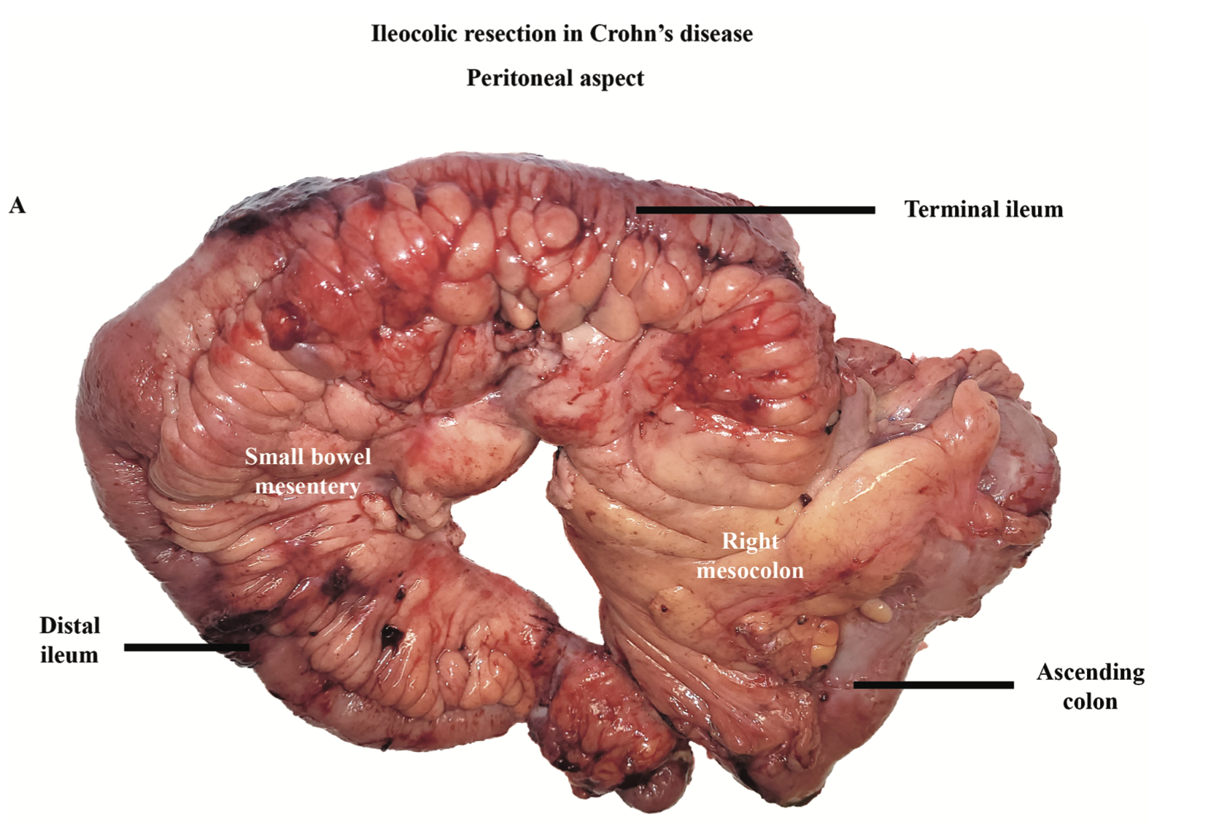
Clin Colon Rectal Surg 2025;38:113–121.
«The mesentery is now defined as the organ in which all abdominal digestive organs develop and then remain connected to»….
Recent studies have recognized the mesentery as a single anatomical and structural unit with functional properties that plays a role in both physiological and pathological mechanisms

Slide 3
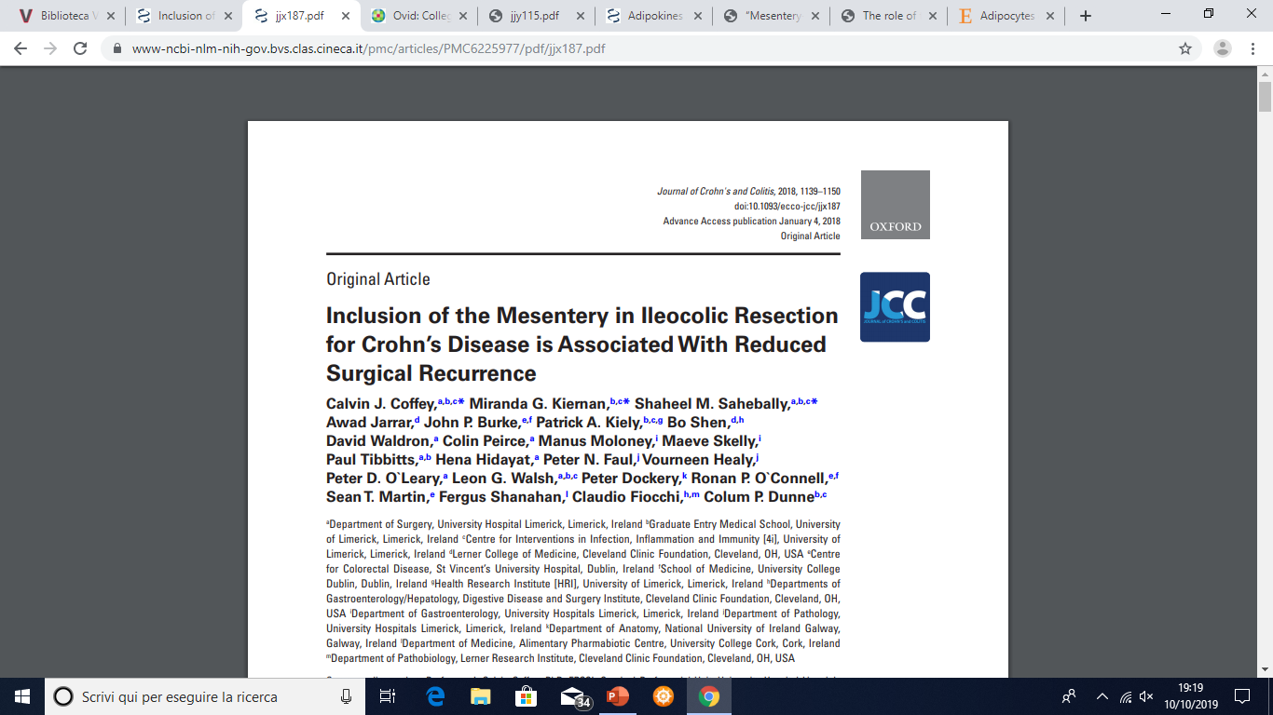
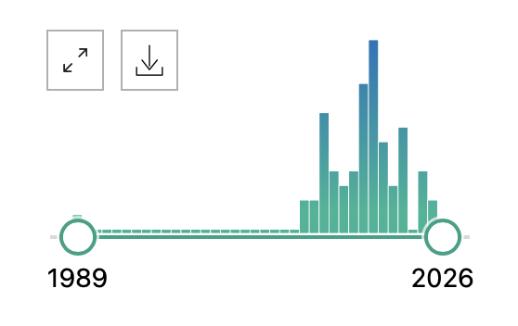
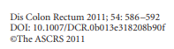
Coffey JC, The Surgical Management of the Mesentery in Crohn's Disease. 2024
2022
2023
2024
2021
2020
2019
2016
2011
2018
2025
2026
Coffey JC
Coffey JC. Mesentery - a 'New' organ. 2020
Coffey JC, The Mesentery-Past, Present, and Future. 2022
Coffey JC Unravelling the Mysteries of the Mesentery in Crohn's Disease. Gastroenterology. 2025
Toru Kono
Sampietro GM,. Prevalence and significance of mesentery thickening. 2022
16
22
29
27
25
24
35
47
13
Coffey, JS
Mesentery, Crohn
Luglio
SuPREMe -CD
2020
Coffey JC…
The mesentery: structure, function, and role in disease. Lancet Gastroenterol Hepatol. 2016
Petrini Mesentery nased surgery: to prevent surgical recurrence in CD, 2019
Turri G,. Intriguing Role of the Mesentery in Ileocolic Crohn's Disease.. 2022
Mineccia M, The Remeasure Study, 2026
Coffey JC,. The mesentery in Crohn's disease: friend or foe? 2016
Meijer LL, Crohn's disease: preserve or resect the mesentery? Br J Surg. 2023
Alibert L, Betton L, Z. Does Kono-S Anastomosis Reduce Recurrence in Crohn's Disease Compared with Conventional Ileocolonic Anastomosis? [KoCoRICCO Study]. J Crohns Colitis. 2024
Rivera ED, Coffey JC, The Mesentery, Systemic Inflammation, and Crohn's Disease. 2019
Mineccia M, The Remedy Study, 2022
Svan der Does de Willebois Spicy study
2024
Notes:
Mesenteric disease activity index. La mesenterci thickening in pedicles dipende dalla presenza di infiammazione solo perivasale o anche nel grasso avascolare.

Slide 4

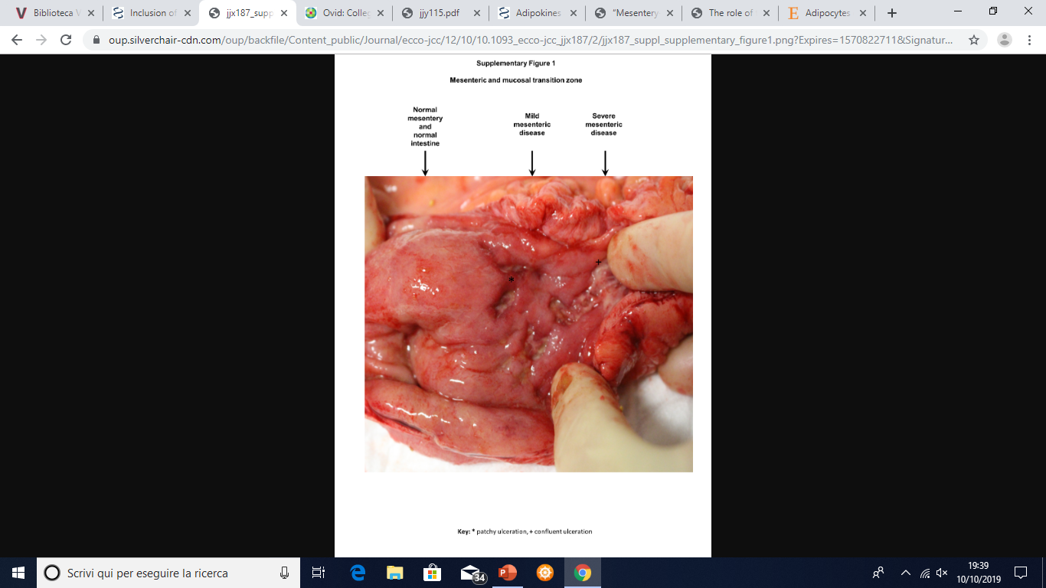
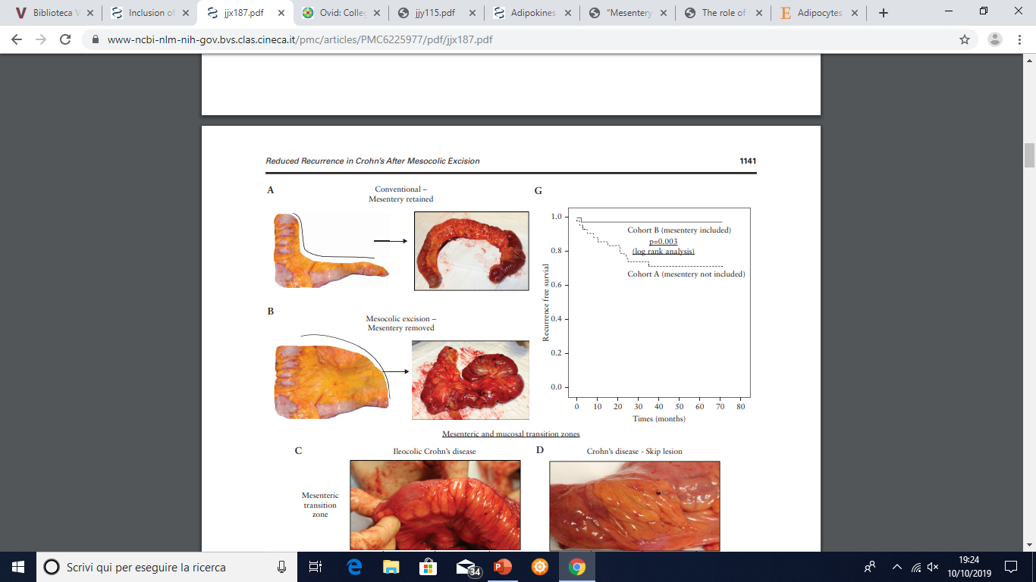

n 34 (1)
n 30 (9+3)
Notes:
Population-based study con confronto di 2 coorti. Coorte A (serie storica) con divisione del mesentere vicino al viscere e resezione intestinale su colon e ileo sano indipendentemente dall’aspetto del meso. Coorte B mesentere asportato con mobilizzazione della sua radice con sezione del viscere immediatamente oltre quella chiamata «transition zone». Coorte C di controllo includendo pazienti con «fat wrapping» > 50% correlandolo alla ripresa di malattia.

Slide 5
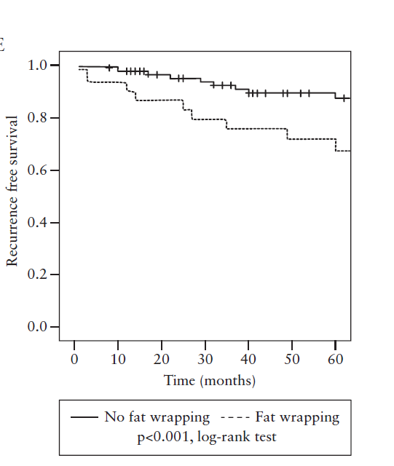
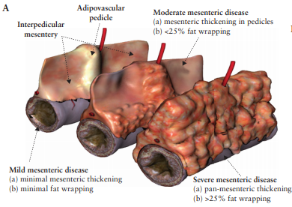
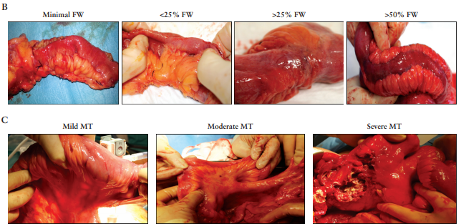
Notes:
Mesenteric disease activity index. La mesenterci thickening in pedicles dipende dalla presenza di infiammazione solo perivasale o anche nel grasso avascolare.

Slide 6
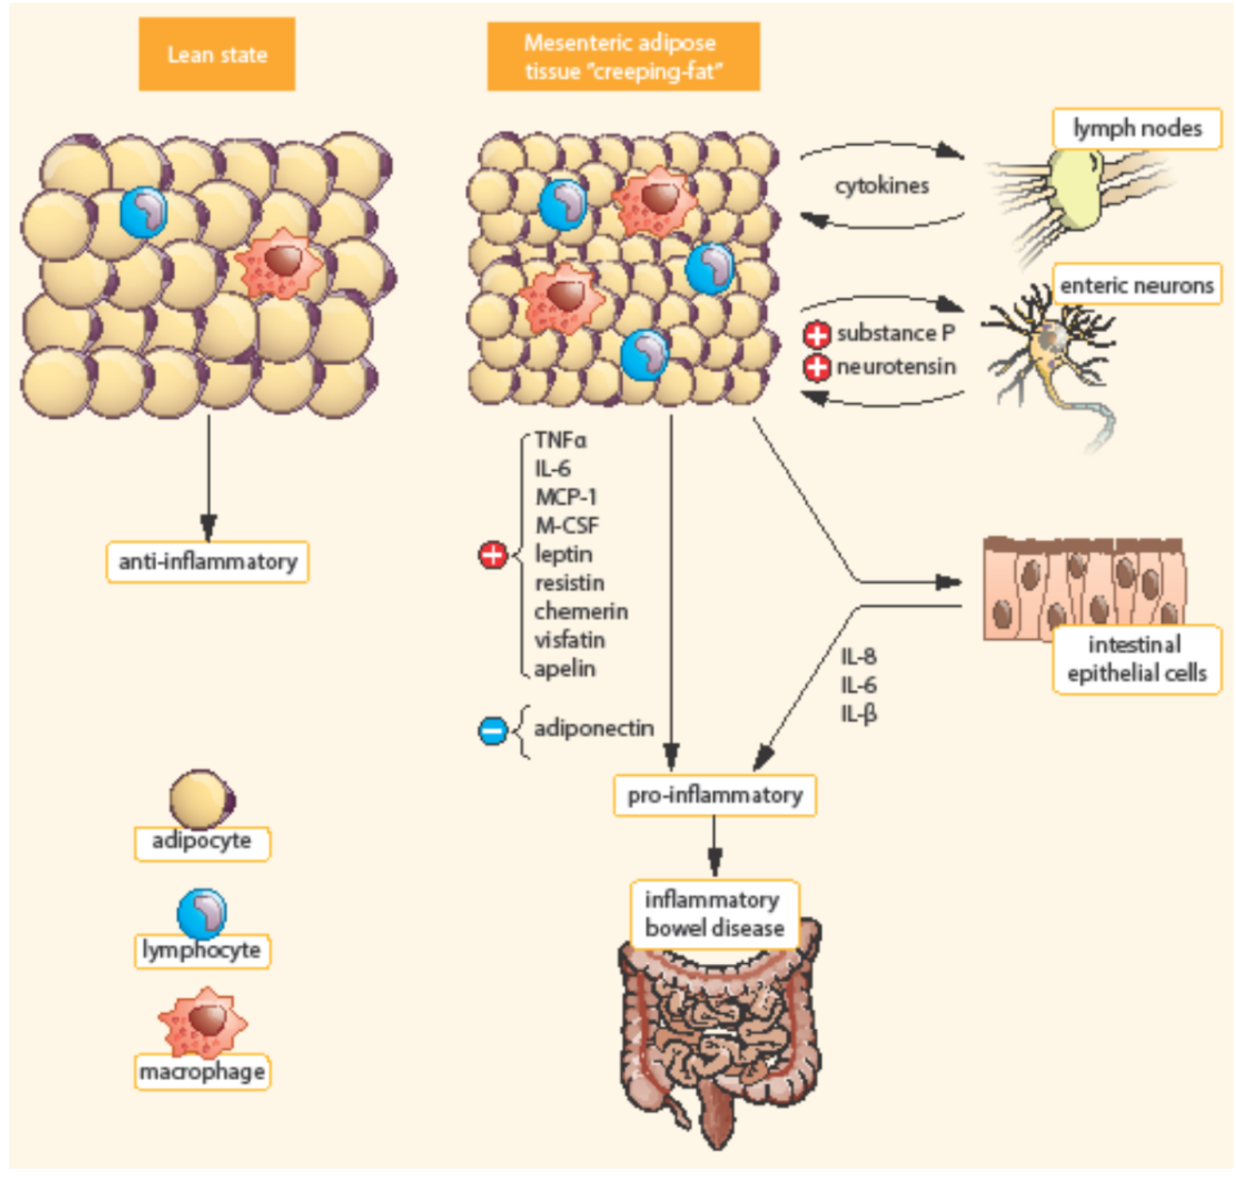
adipociytes, endothelial cells, immune cells, fibroblasts, pre-adipocytes, and stem cells
Wrapping fat
Secretes a broad spectrum of mediators
citochine, adipokines, fatty acids, growth factors
transmural inflammation, intestinal fibrosis.
Fat wrapping, together with muscular hypertrophy and intestinal fibrosis, may participate in the stricturing form of CD

Slide 7
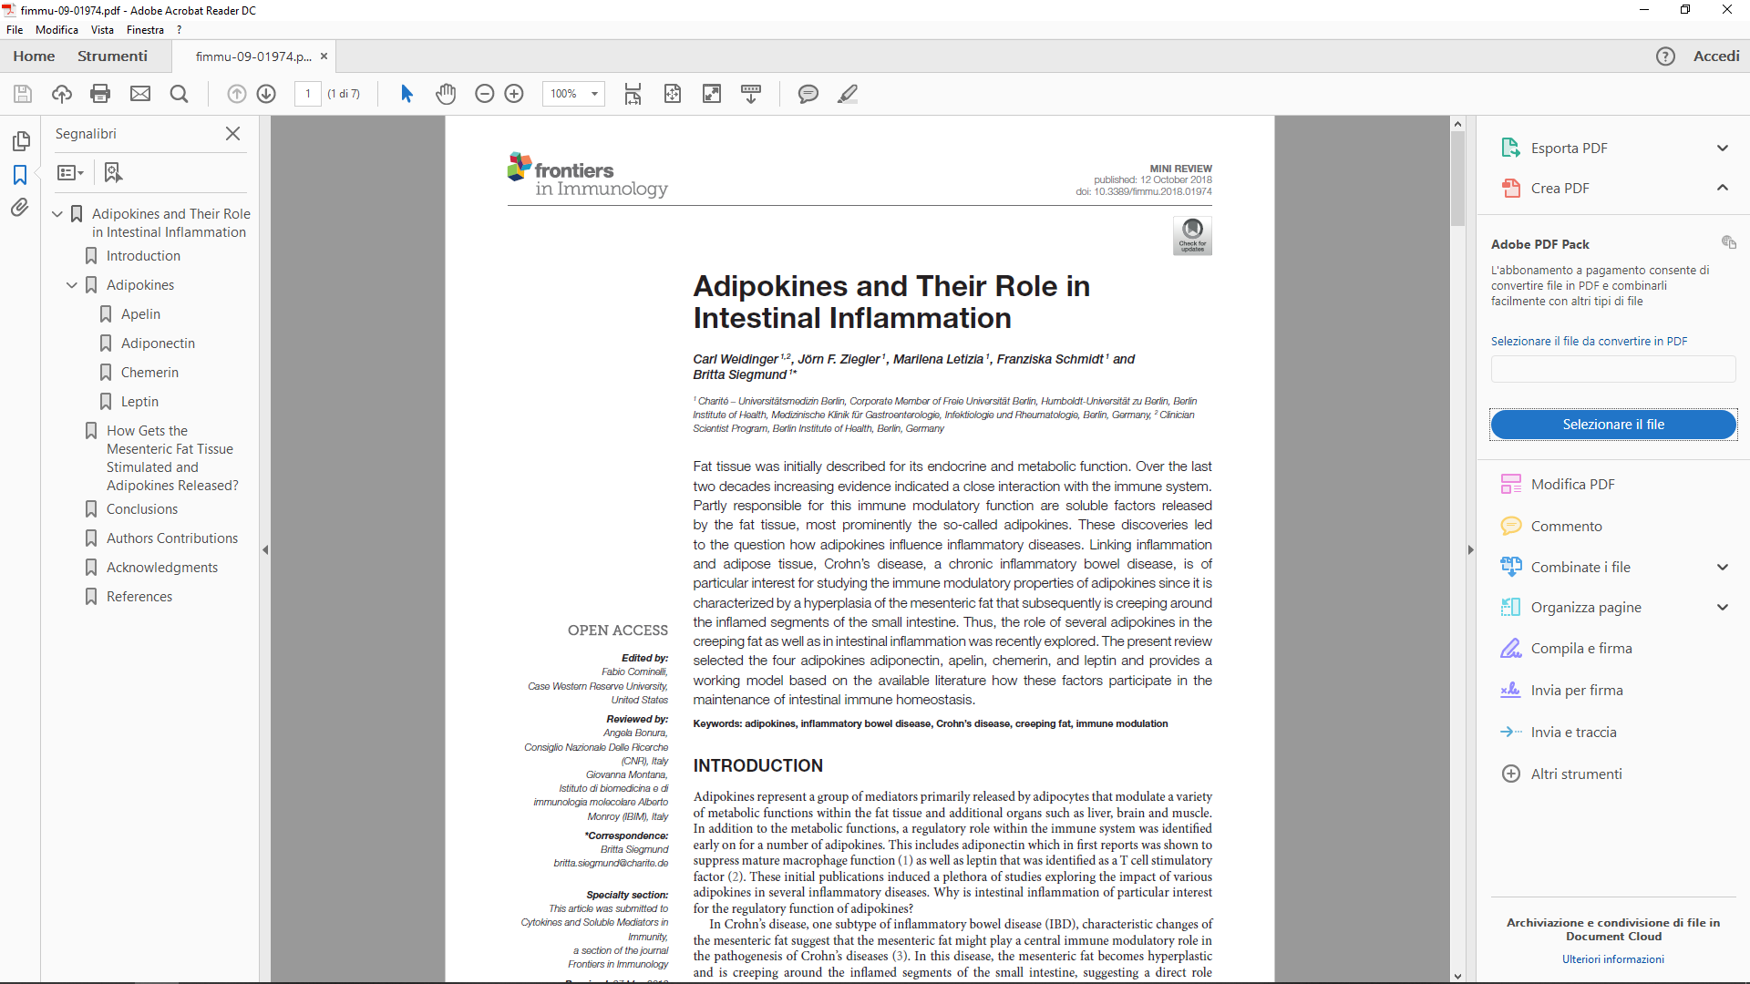
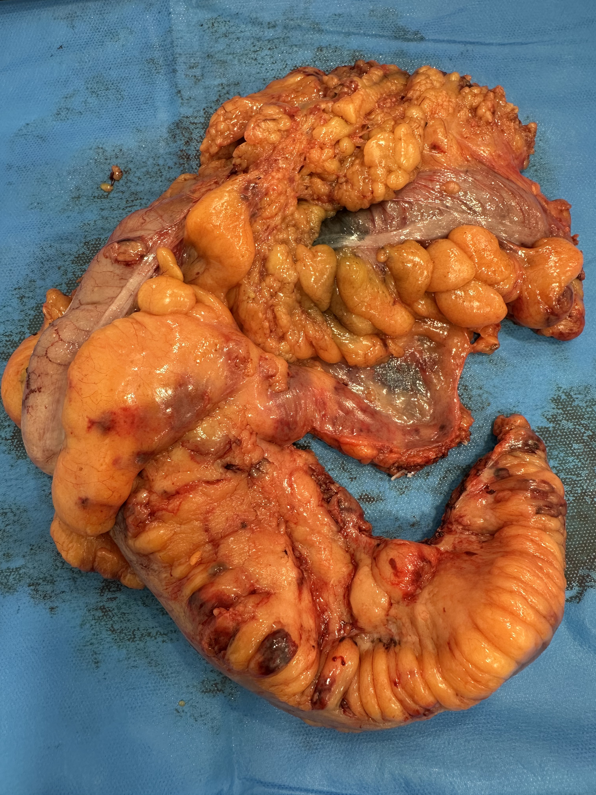
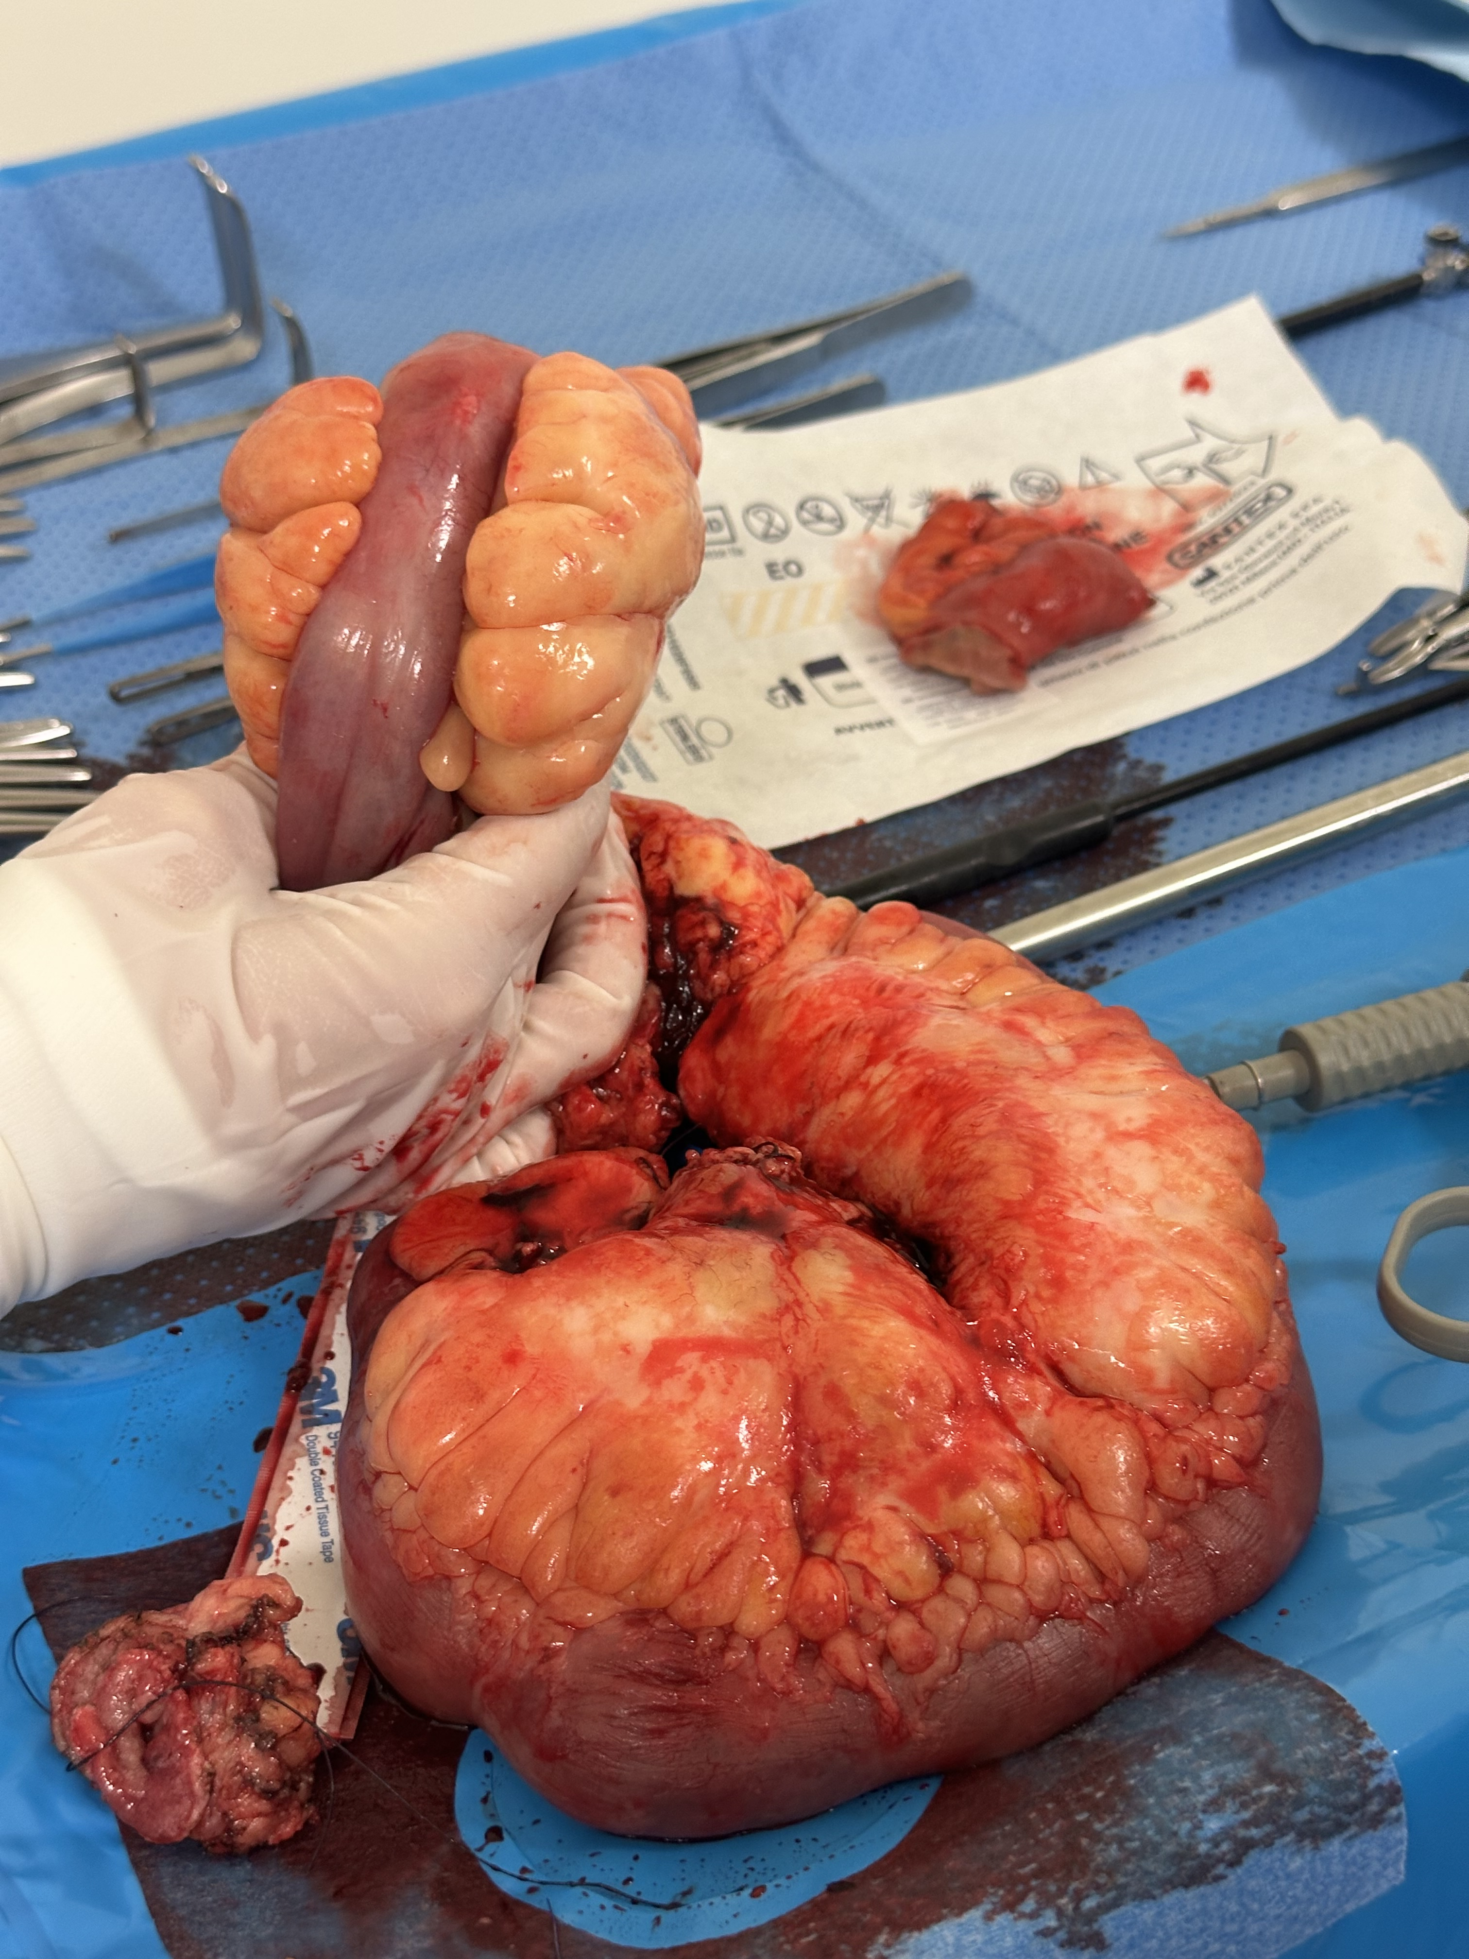
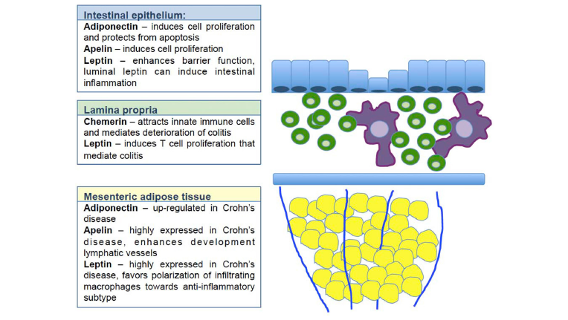
group of mediators primarily released by adipocytes that modulate a variety of metabolic functions within the fat tissue and additional organs such as liver, brain and muscle.
Adipokines
adiponectin,
apelin,
chemerin,
leptin

Slide 8
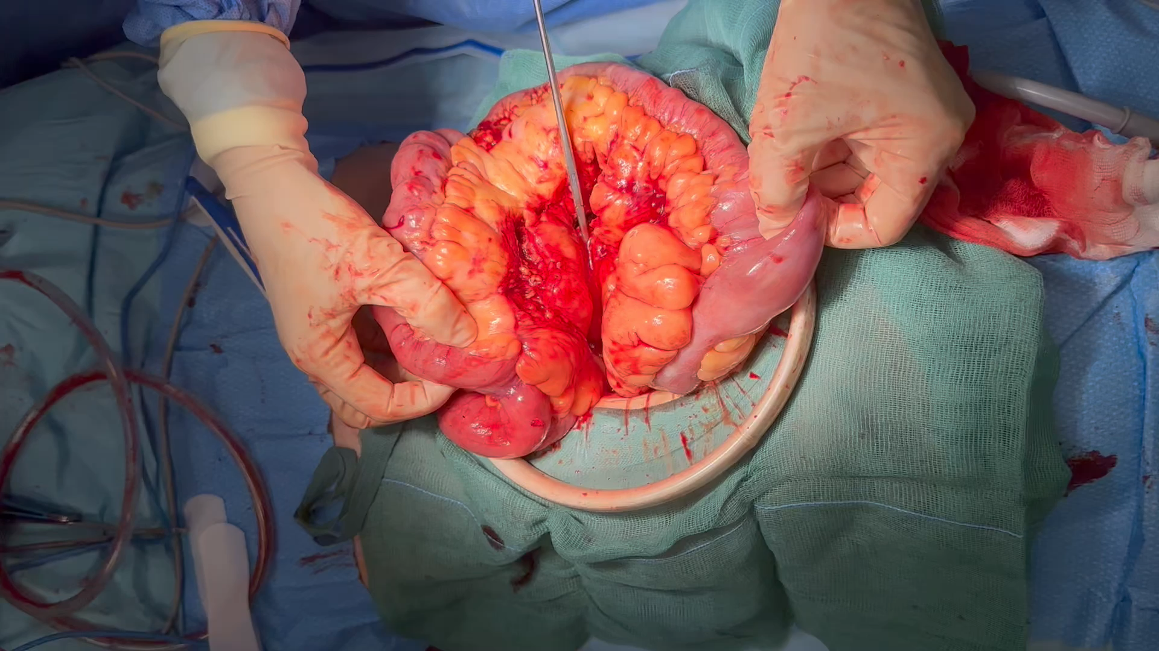

Slide 9
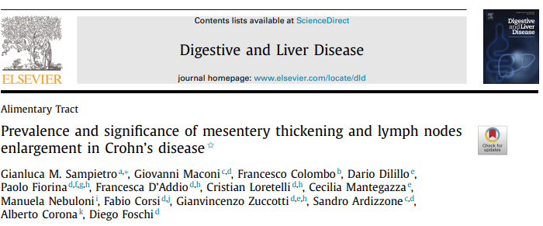
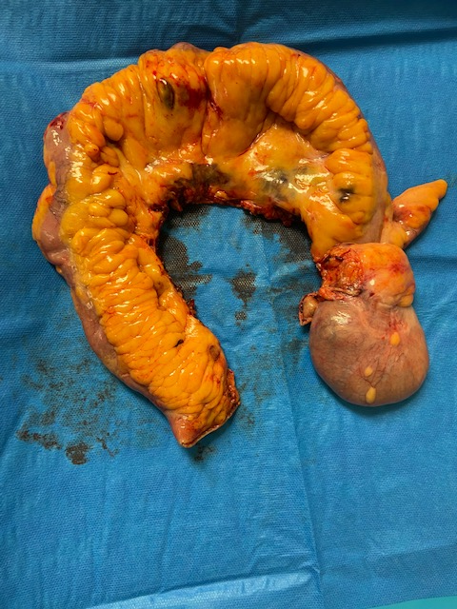
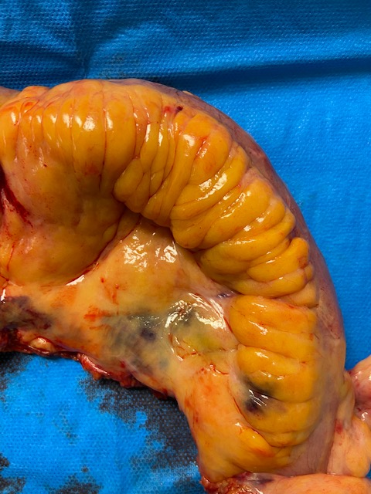
PREVALENCE - SIGNIFICANCE
1272
744 (S0, 58,5%)
Thickened mesentery: when the thickness was more
than 5 mm, and/or when the wrapping fat involved
more than 180° of bowel girth, with vascular and lymphatic retraction
Lymphopathy: 3 or more lymphnodes, greater than 4 mm,
in the mesentery tributary of a diseased bowel segment
331 (S1, 26%)
126 (S2, 10%)
71 (S3, 5,5%)

Slide 10
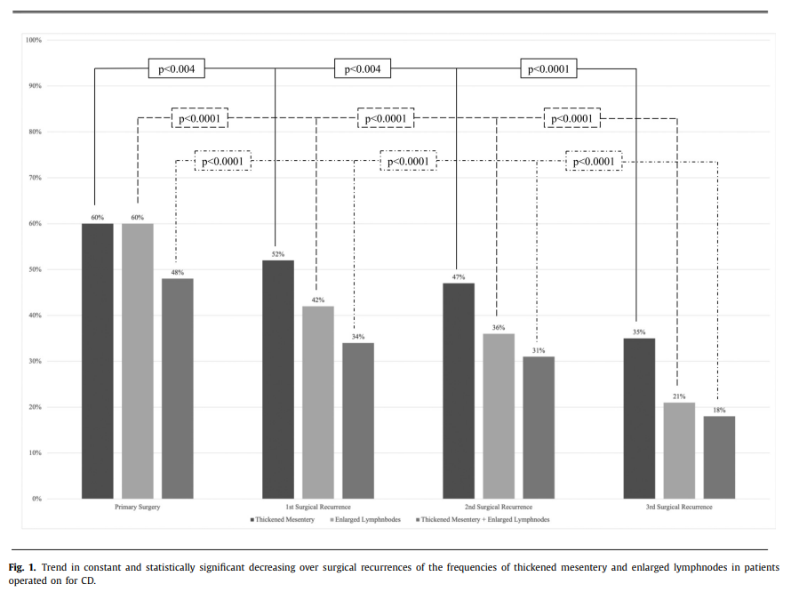
thickened mesentery: more frequent older age at diagnosis and at surgery
lymphopathy shorter time between diagnosis and first surgery
As the disease progresses and recurrences occur, lymphnodes enlargement seems related to a worse nutritional status, and both thickened mesentery and lymphopathy to the presence of intra-abdominal septic complications at the moment of surgery

Slide 11
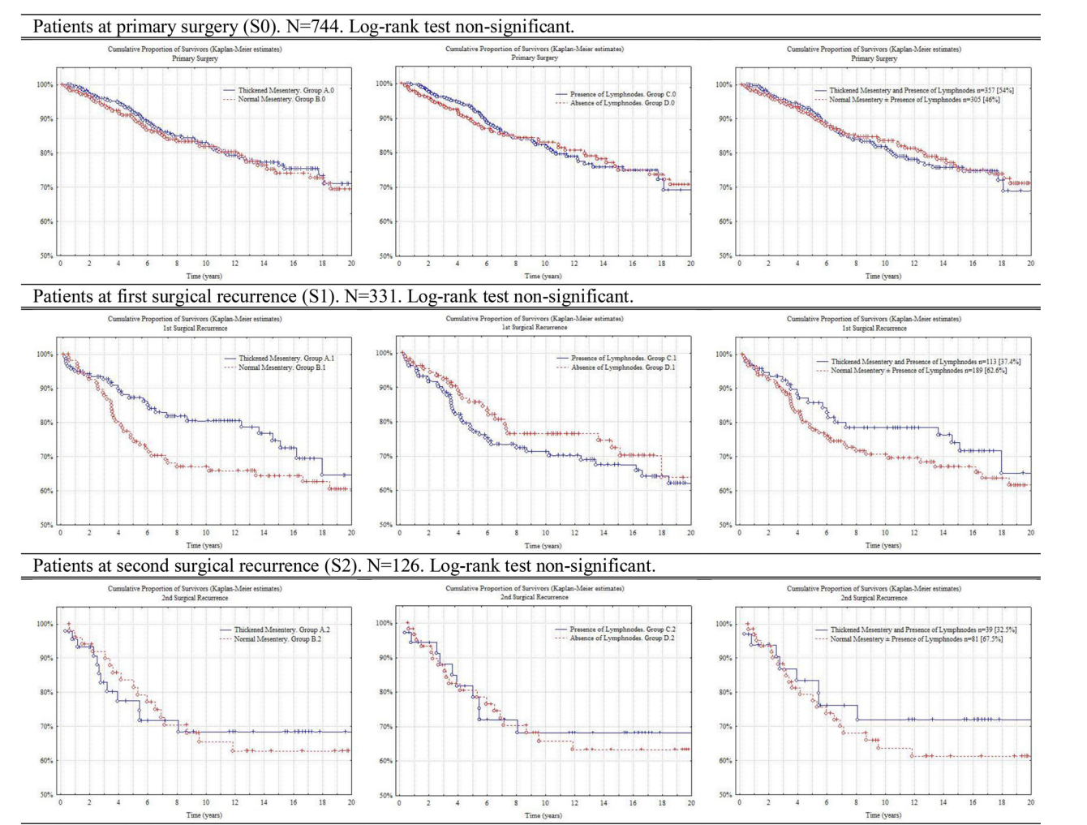
Thick-mes vs normal
Limphopaty vs no
Both vs normality

Slide 12
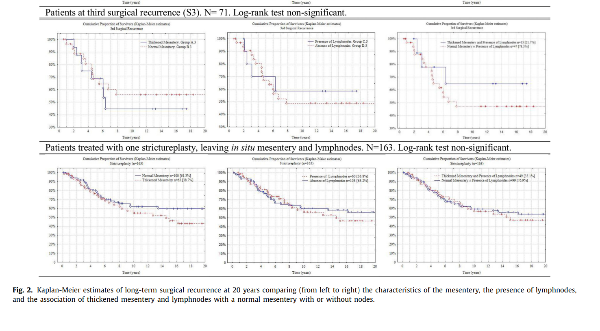

Slide 13
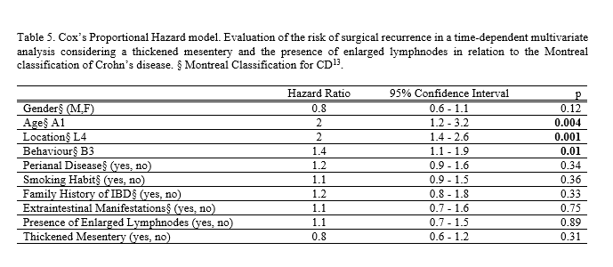
age at diagnosis below 16
upper-GI location (L4)
perforating disease behaviour (B3)
but not the presence of enlarged lymphnodes and thickened mesentery, showed an increased risk of long-term surgical recurrence.

Slide 14
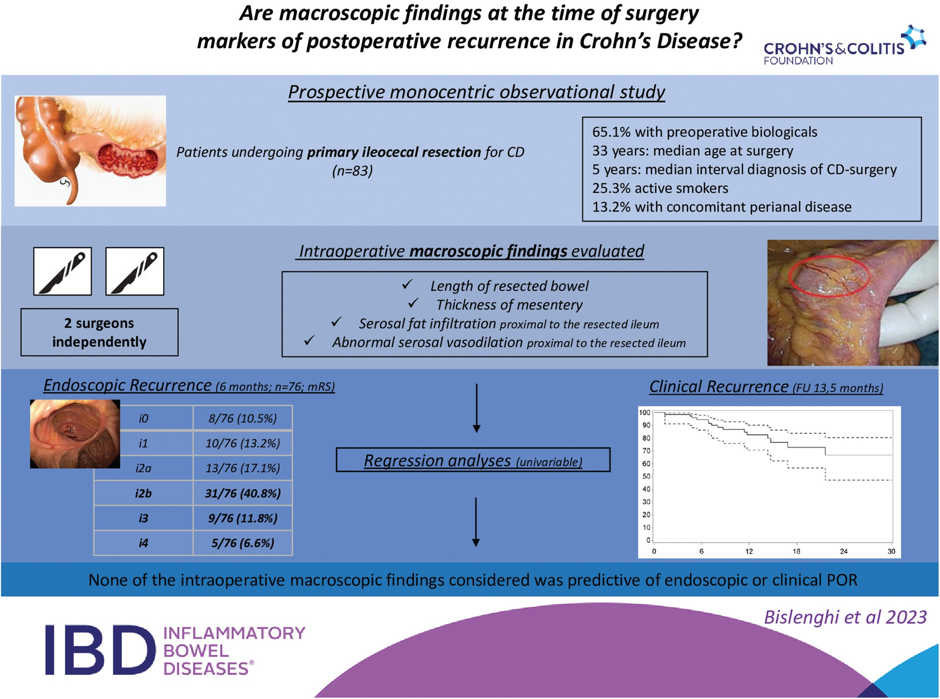
PREVALENCE - SIGNIFICANCE
83
early endoscopic recurrence, clinical recurrence

Slide 15
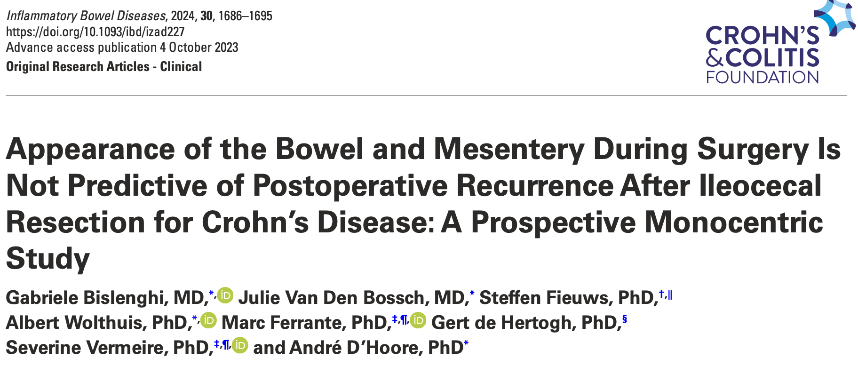
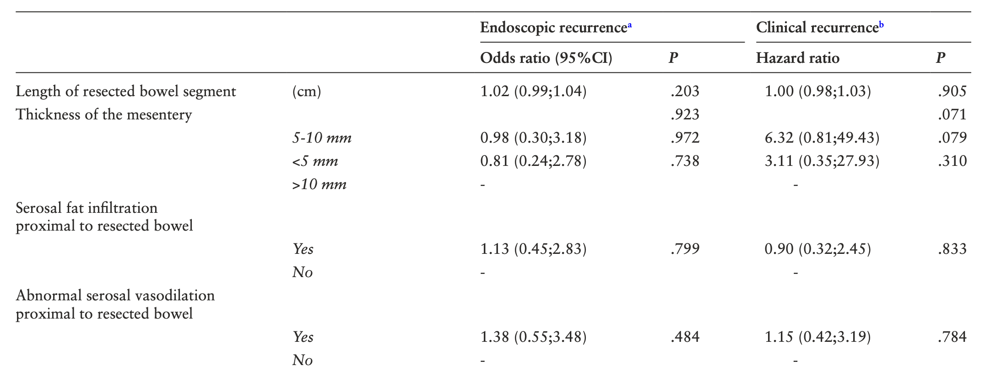
The macroscopic appearance of the bowel and associated mesentery during surgery does not seem to be predictive of POR after ileocecal resection for CD

Slide 16
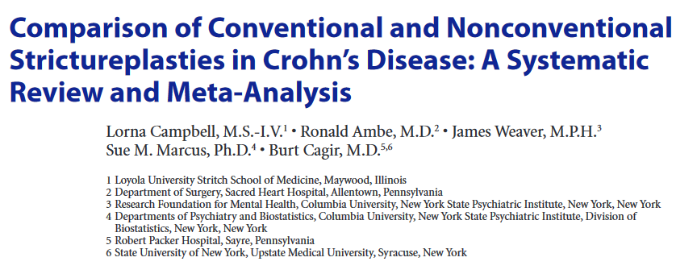
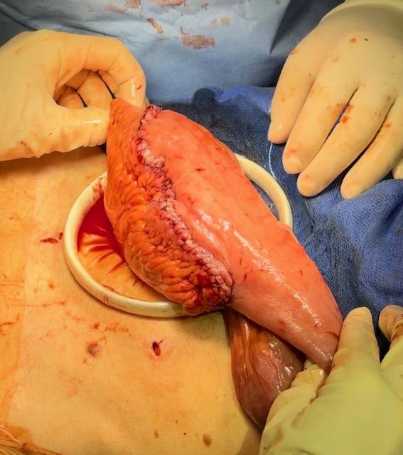
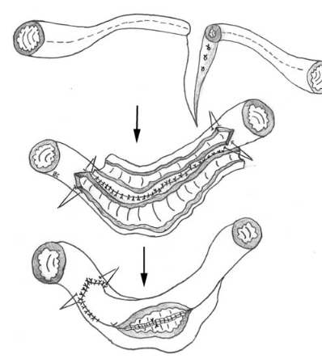
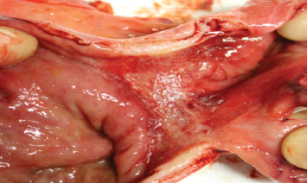
the diseased bowel and mesentery treated by SP have been shown to return to normal within 12 months after surgery, with evidence of radiographic, endoscopic, histologic, and cytokine production normalization of the treated bowel segment within one year after surgery…..
DISEASES OF THE COLON & RECTUM VOLUME 55: 6 (2012)

Slide 17

Resect or spare?
Notes:
Mesenteric disease activity index. La mesenterci thickening in pedicles dipende dalla presenza di infiammazione solo perivasale o anche nel grasso avascolare.

Slide 18

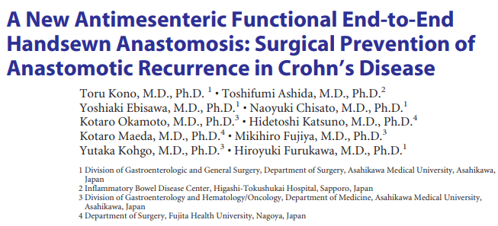
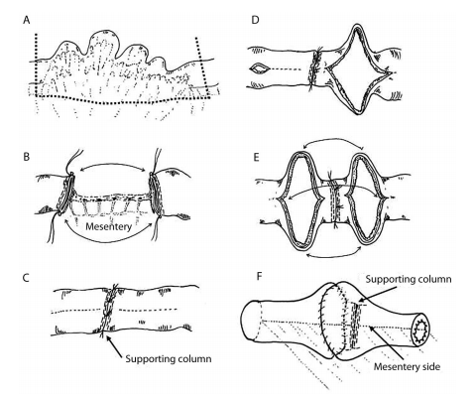
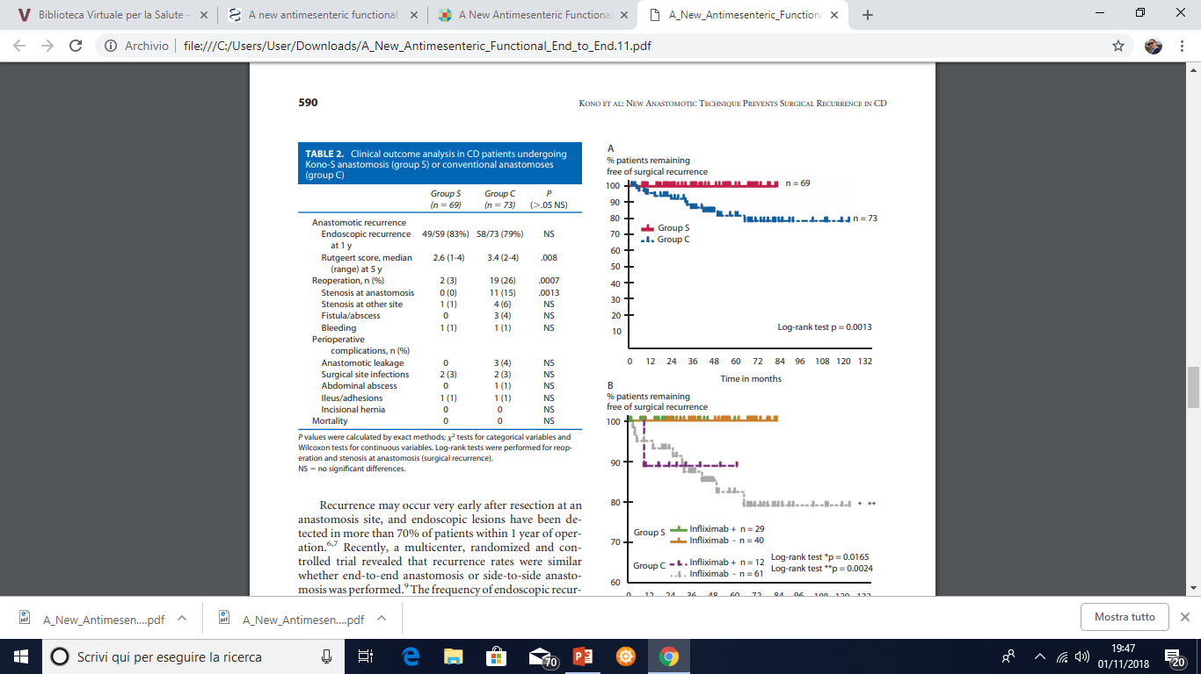
KONO

Slide 19
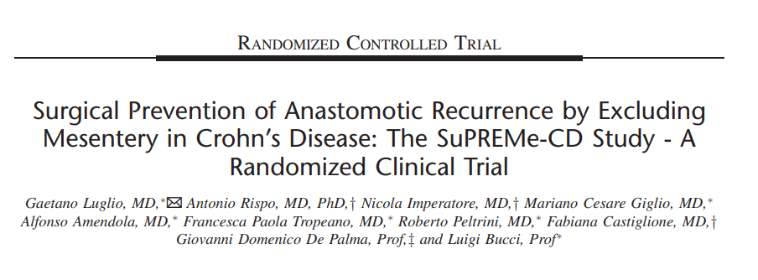
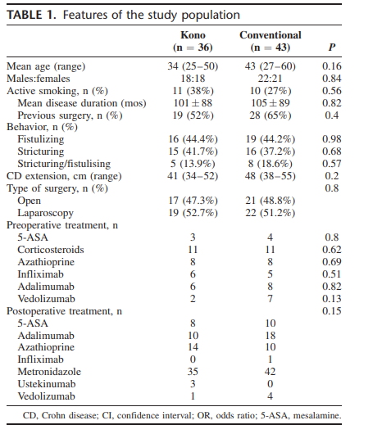
SuPREMe
Annals of Surgery, 2020
Randomized controlled trial (RCT)
Primary endpoint: endoscopic recurrence (ER) (Rutgeerts score i2) after 6 months.
Secondary endpoints: clinical recurrence (CR) after 12 and 24
months, ER after 18 months, and surgical recurrence (SR) after 24 months

Slide 20
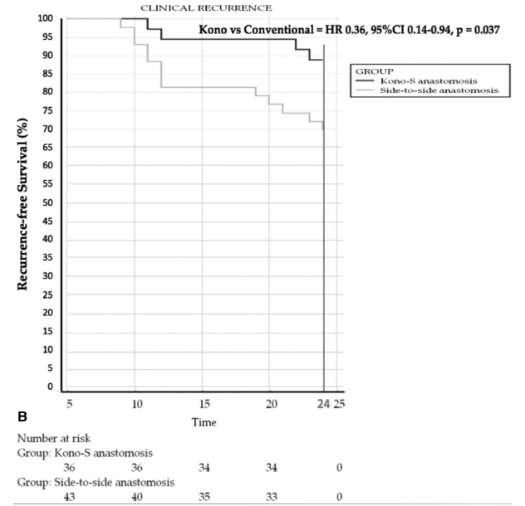
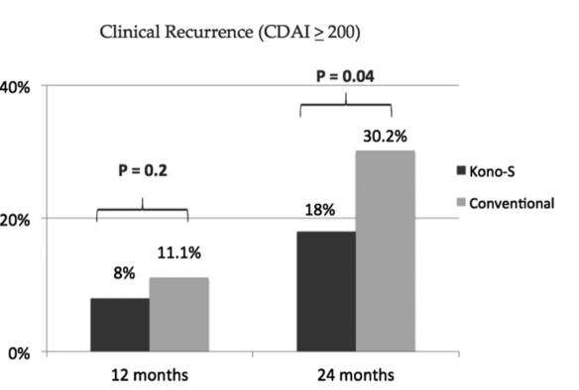
SuPREMe
Results and conclusions
significant reduction in postoperative endoscopic recurrence rate, and also a dramatic decrease in the severity of endoscopic recurrence score by using the Kono-S technique, with no safety issues
Kono-S anastomosis should be considered as a new technique in surgical management of CD in tertiary referral centers.

Slide 21
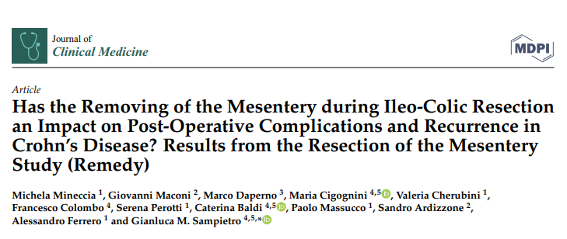

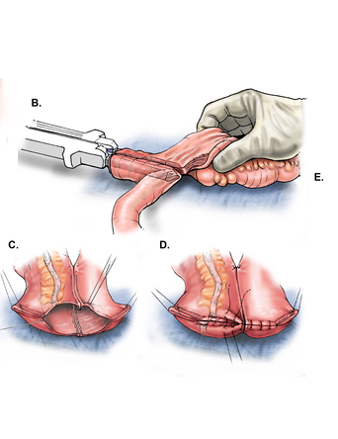
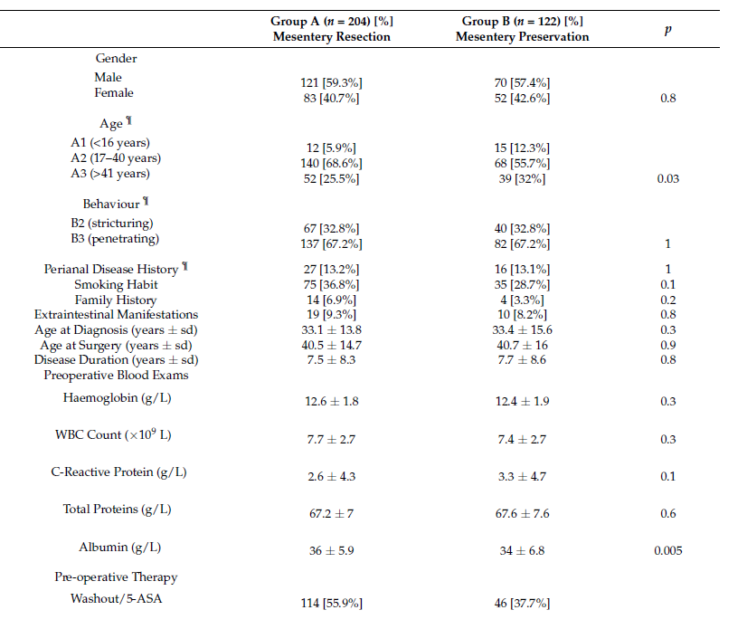
2022
REMEDY

Slide 22
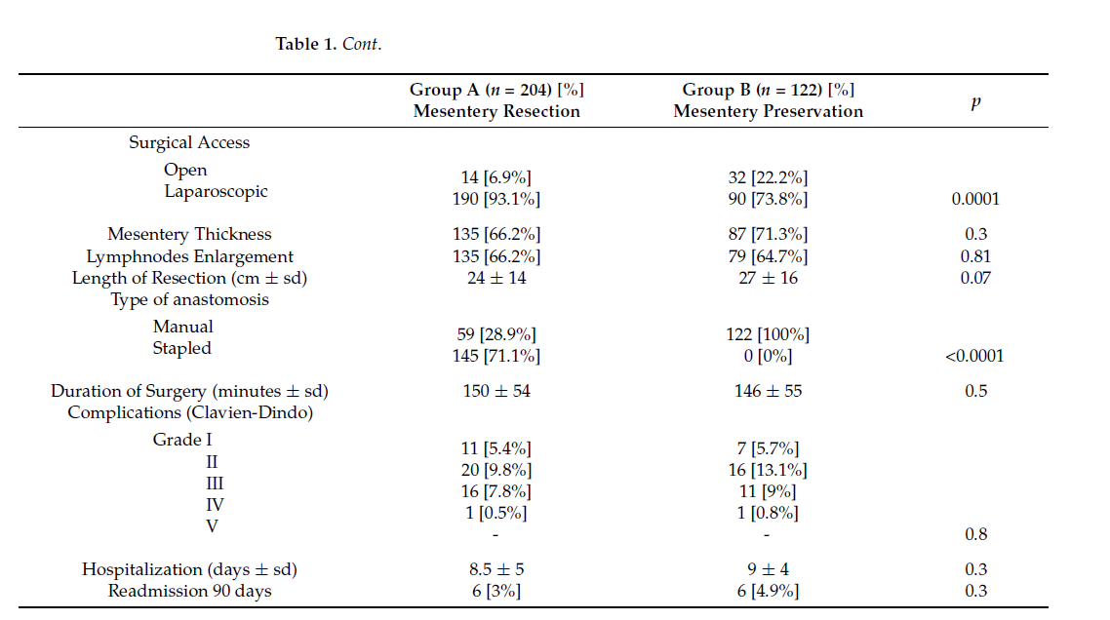
REMEDY

Slide 23
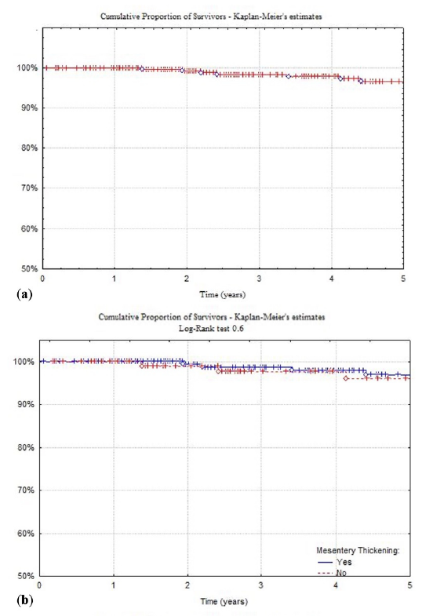
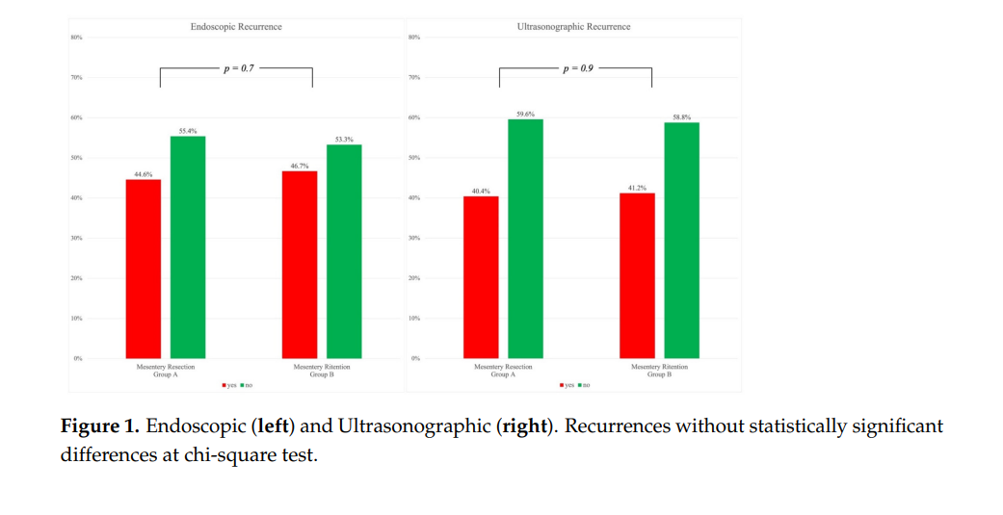
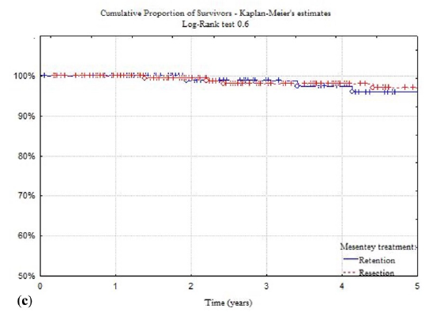
REMEDY

Slide 24

Clin Colon Rectal Surg 2025;38:113–121.
……the reoperation rates in that study were already at the level that would be expected with mesenteric inclusion or with Kono-S. Given that, it is unlikely that further reductions would be observed in the first place. In addition, the reported hazard ratio trended toward significance. Thus, it is possible that if reoperation rates in the control group were even marginally higher, then a significant difference could have emerged.

Slide 25
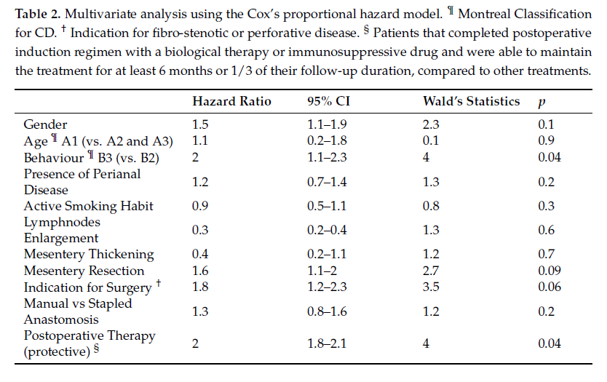
REMEDY
perforating disease Behavior (B3)
postoperative adjuvant treatment with biological or immunosuppressants

Slide 26
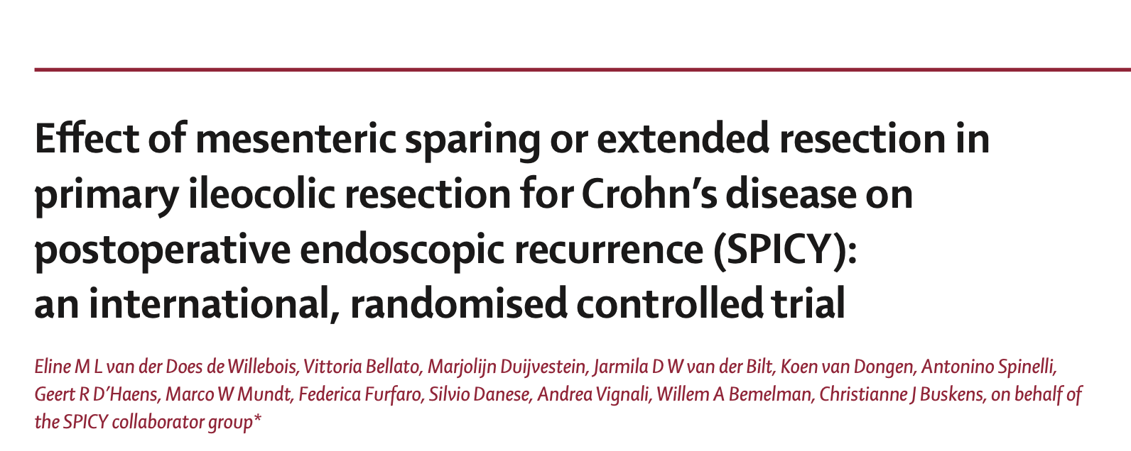
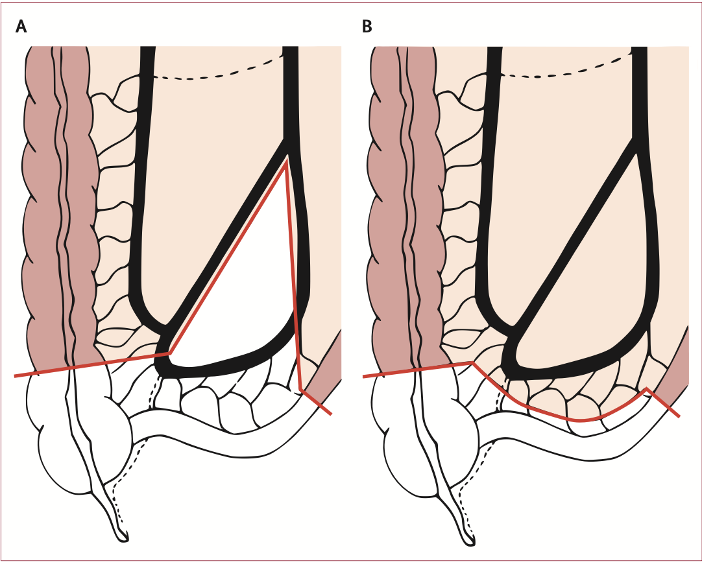
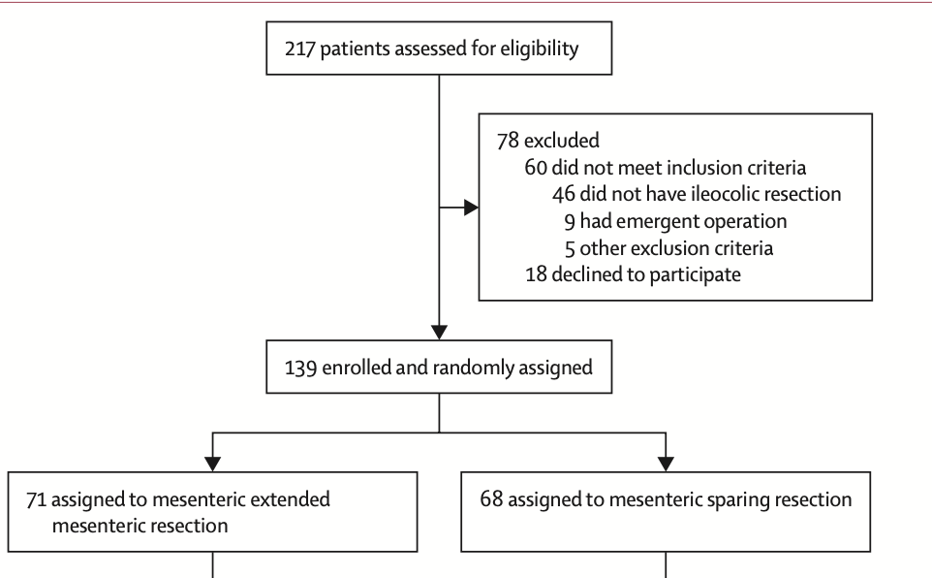








Slide 27
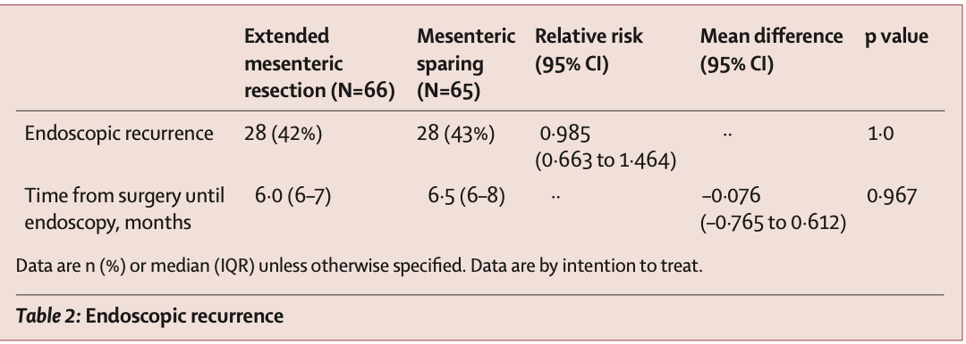
In conclusion, these data support the guideline-recommended mesenteric sparing approach, as the
results of this study showed no superiority of extended mesenteric resection with regard to endoscopic
recurrence or other perioperative outcomes, and there was a non-significant trend toward a lower risk of severe complications in the mesenteric sparing group.

Slide 28
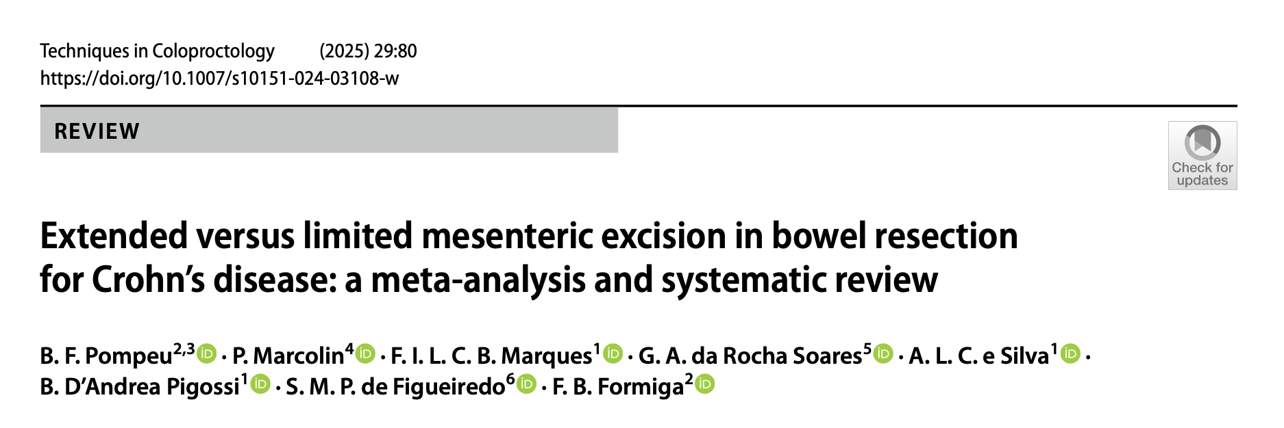
1 (RCT,) and 4 observ. 4498 patients
1059 (23.5%) underwent EME and 3439 (76.5%) LME.
EME was associated with a lower surgical recurrence rate (5% versus 15%; OR 0.31; 95% CI 0.12–0.84; p = 0.021; I2 = 47%).
No significant differences between EME and LME for: overall complications,
Clavien–Dindo ≥ 3 events, bleeding requiring transfusion, anastomotic leaks, intraabdominal abscesses, surgical site infections (SSIs), reoperations, readmissions, ileus, endoscopic recurrences, operative times, or hospital stays.

Slide 29
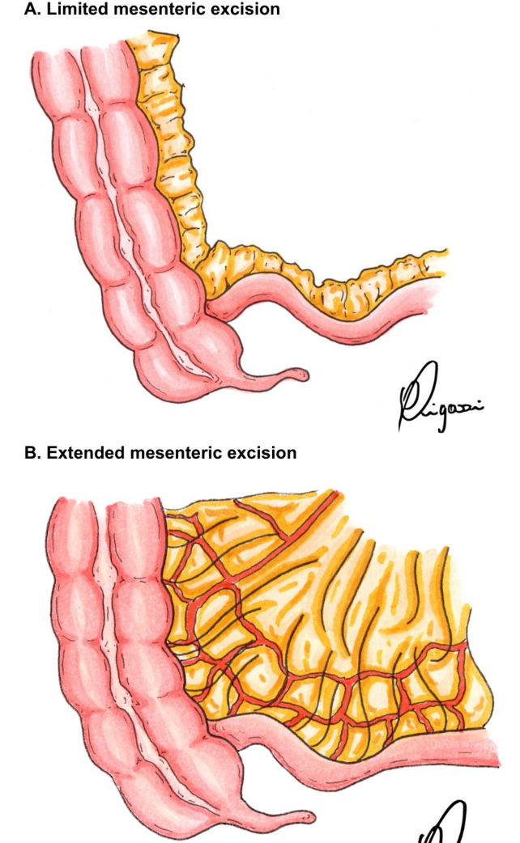

Slide 30


Slide 31



Slide 32


KoCoRicco

Slide 33


Slide 34


PRT: 8 centers
366 enrolled patients
192 kono-S vs 174 side to side
255 patients completed 12-18 months follow up
22 min longer Kono (not sign)
No Mortality
12-18 months endoscopy: no differences between the two groups
31,6 Kono S
33,3 S to S
Overall 32,4

Slide 35



Slide 36




HAND 2 END
Optimizing surgical anastomosis in ileocolic resection for Crohn's disease to reduce recurrent disease:
A Randomized controlled trial comparing manual ileocolic anastomosis Handsewn (end-to-end or Kono-s) and lateral-lateral mechanical anastomosis (HAND2END study).
PNRR-MAD-2022-12376751
Types of anastomosis: Advised in ECCO guidelines
MECHANICAL side-to-side
MANUAL end-to-end
MANUAL Kono-S

Slide 37

Current Status
RCCS Ospedale San Raffaele, Ospedale Universitario Vanvitelli Napoli, IRCCS Humanitas Research Hospital
IRCCS Ospedale Sacro Cuore Don Calabria, Ospedale Sacco Milano, Ospedale di Rho, ASO Ordine Mauriziano,
AOU Federico II, Napoli, AOU Cagliari

Slide 38


Slide 39


  In conclusion
  The resection of the mesentery has to be clarified in terms of:
    Thickening (vascular control and complications)
    Lymphnodes (number, size and characteristics)
    Inflammatory mediator (patient’s response to drug therapy)
    And does not seem to reduce surgical, endoscopic and ultrasonographic recurrence rate within one year
Weather the mesentery is resected or retained, early immunosuppressive or biological adjuvant therapy has a significant impact in preventing surgical recurrence.
Based on this evidence, the actual wave of “mesentery targeted” surgery needs further studies to be validated and cannot be currently recommended in all patients and for all surgeons.

Slide 40


Slide 41

@Michel_Mineccia
𝕏
mmineccia@mauriziano.it

